Slide 1
Probability Distributions
II

Slide 2
Multinomial Distribution - Motivation
Suppose we modified assumption (1) of the binomial distribution to allow for more than two outcomes.
For example, suppose that for the family with parents that are heterozygote carriers of a recessive trait, we are interested in knowing the probability of
Q₁: One of their n=3 offspring will be unaffected (AA), 1 will be affected (aa) and one will be a carrier (Aa),
Q₂:All of their offspring will be carriers,
Q₃:Exactly two of their offspring will be affected (aa) and one will be a carrier.

Slide 3
Multinomial Distribution - Motivation
For each child, we can represent these possibilities with three indicator variables for the i-th child as
Y_{i1} = 1 if unaffected (AA), & 0 otherwise
Y_{i2} = 1 if carrier (Aa), & 0 otherwise
Y_{i3} = 1 if affected (aa), & 0 otherwise
Notice only one of the three Y_{i1}, Y_{i2}, Y_{i3} can be equal to 1, so Σ_{j} Y_{ij} = 1.
For the binomial distribution with 2 outcomes, there are 2^{n} unique outcomes in n trials. In the family with n=3 children, there are 2³ = 8 unique outcomes.
For the multinomial distribution with n trials and only 3 outcomes, the number of unique outcomes is 3^{n}. For our small family, that’s 3³=27 outcomes.

Slide 4
Possible Outcomes
Combinations: As with the binomial, there are different ways to arrange possible outcomes from a total of n objects (trials) if order doesn’t matter. For the multinomial distribution, the combinations are summarized as
where the k_{j} (j=1,2,…,J) correspond to the totals for the different outcomes.
E.g. (n=2 offspring)
Child number
1 2 Outcomes
AA AA 2 unaffected, 0 carrier, 0 affected
AA Aa 1 unaffected, 1 carrier, 0 affected
Aa AA 1 unaffected, 1 carrier, 0 affected
AA aa 1 unaffected, 0 carrier, 1 affected
aa AA 1 unaffected, 0 carrier, 1affected
Aa Aa 0 unaffected, 2 carrier, 0 affected
aa Aa 0 unaffected, 1 carrier, 1 affected
Aa aa 0 unaffected, 1 carrier, 1 affected
aa aa 0 unaffected, 0 carrier, 2 affected

Slide 5
For the case of n=2 offspring (i.e., trials), what are the probabilities of these outcomes?
E.g. (n=2, k₁=unaffected, k₂=carrier, k₃=affected)
Child number
1 2 Outcomes # ways
p₁ p₁ k₁=2,k₂=0,k₃=0 1
p₁ p₂ k₁=1,k₂=1,k₃=0 2
p₂ p₁ k₁=1,k₂=1,k₃=0
p₁ p₃ k₁=1,k₂=0,k₃=1 2
p₃ p₁ k₁=1,k₂=0,k₃=1
p₂ p₂ k₁=0,k₂=2,k₃=0 1
p₃ p₂ k₁=0,k₂=1,k₃=1 2
p₂ p₃ k₁=0,k₂=1,k₃=1
p₃ p₃ k₁=0,k₂=0,k₃=2 1
For each possible outcome, the probability Pr[Y₁=k₁, Y₂=k₂, Y₃=k₃] is
p₁^{k1}p₂^{k2}p₃^{k3}
There are sequences for each
probability, so in general…

Slide 6
Multinomial Probabilities
What is the probability that a multinomial random variable with n trials and success probabilities p₁, p₂, …, p_{J} will yield exactly k₁, k₂,…k_{J} successes?
Assumptions:
1) J possible outcomes – only one of which can be a success (1) a given trial.
2) The probability of success for each possible outcome, p_{j}, is the same from trial to trial.
3) The outcome of one trial has no influence on other trials (independent trials).
4) Interest is in the (sum) total number of “successes” over all the trials.
k₁ k₂ k₃ k₄
k_{J-1} k_{J}
n = Σ_{j} k_{j} is the total number of trials.

Slide 7
Multinomial Probabilities - Examples
Returning to the original questions:
Q₁: One of n=3 offspring will be unaffected (AA), one will be affected (aa) and one will be a carrier (Aa) (recessive trait, carrier parents)?
Solution: For a given child, the probabilities of the three outcomes are:
p₁ = Pr[AA] = 1/4, p₂ = Pr[Aa] = 1/2, p₃ = Pr[aa] = 1/4.
We have

Slide 8
Quiz
What is the probability that all three offspring will be carriers?
What is the probability that exactly two offspring will be affected and one a carrier?

Slide 9
Solutions
Q₂: What is the probability that all three offspring will be carriers?
Q₃: What is the probability that exactly two offspring will be affected and one a carrier?

Slide 10
Example - Mean and Variance
It turns out that the (marginal) outcomes of the multinomial distribution are binomial. We can immediately obtain the means for each outcome (i.e., the j^{th} cell) MEAN:
VARIANCE:
COVARIANCE:

Slide 11
Multinomial Distribution Summary
Multinomial
1. Discrete, bounded
2. Parameters - n, p₁, p₂,…,p_{J}
Sum of n independent outcomes
Extends binomial distribution
5. Polytomous regression, contingency tables

Slide 12
Continuous Distributions

Slide 13
Continuous Distributions
For measurements like height and weight which can be measured with arbitrary precision, it does not make sense to talk about the probability of any single value. Instead we talk about the probability for an interval.
P[weight = 70.000kg] ≈ 0
P[69.0kg < weight < 71.0kg] = 0.08
For discrete random variables we had a probability mass function to give us the probability of each possible value. For continuous random variables we use a probability density function to tell us about the probability of obtaining a value within some interval.

Slide 14
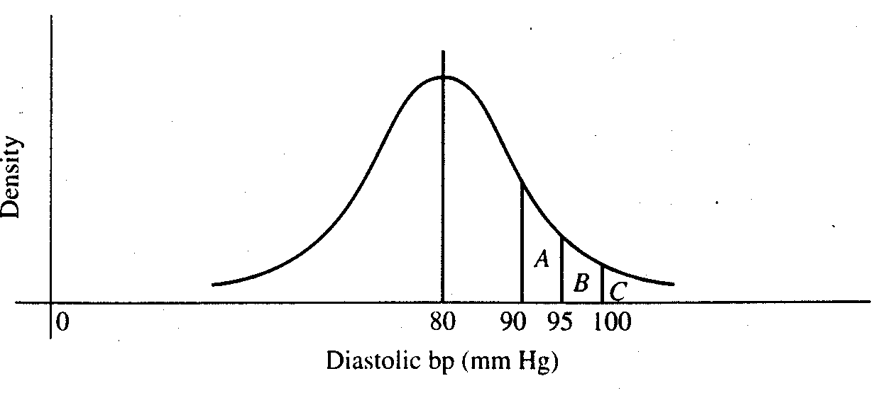
With discrete probability distributions, we can determine the probability of a single outcome, e.g.:
With continuous probability distributions, we can determine the probability across a range of outcomes:
For any interval, the area under the curve represents the probability of obtaining a value in that interval.

Slide 15
Probability density function
1. A function, typically denoted f(x), that gives probabilities based on the area under the curve.
2. f(x) > 0
3. Total area under the function f(x) is 1.0.
Cumulative distribution function
The cumulative distribution function, F(t), tells us the total probability less than some value t.
F(t) = P(X < t)
This is analogous to the cumulative relative frequency.

Slide 16
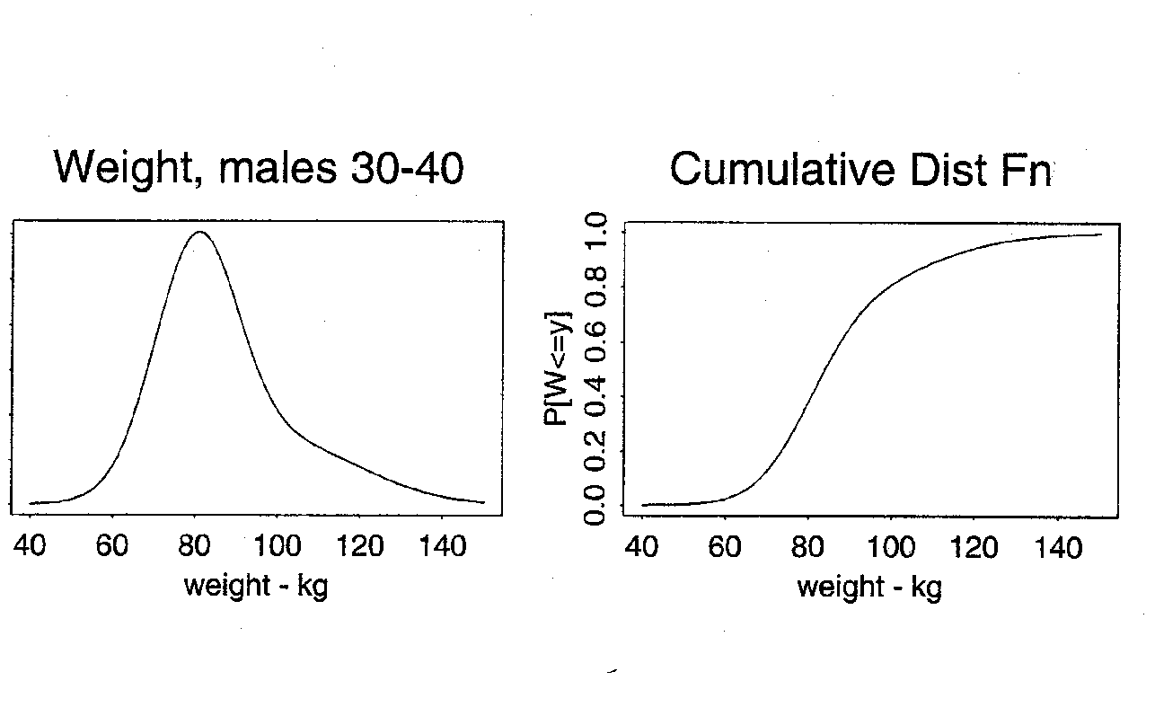
Prob[wgt < 80]
Area under the curve
= 0.40

Slide 17
Normal Distribution
A common probability model for continuous data
Bell-shaped curve
takes values between -∞ and + ∞
symmetric about mean
mean=median=mode
Examples (common but questionable!)
birthweights
blood pressure
CD4 cell counts (perhaps transformed)
The normal distribution is more useful
as a derived distribution,
as we will see when we talk about the
central limit theorem…

Slide 18
Normal Distribution
Specifying the mean and variance of a normal distribution completely determines the probability distribution function and, therefore, all probabilities.
The normal probability density function is:
where
π ≈ 3.14 (a constant)
Notice that the normal distribution has two parameters:
μ = the mean of X
σ = the standard deviation of X
We write X~N(μ , σ²). The standard normal distribution is a special case where μ = 0 and σ = 1.

Slide 19
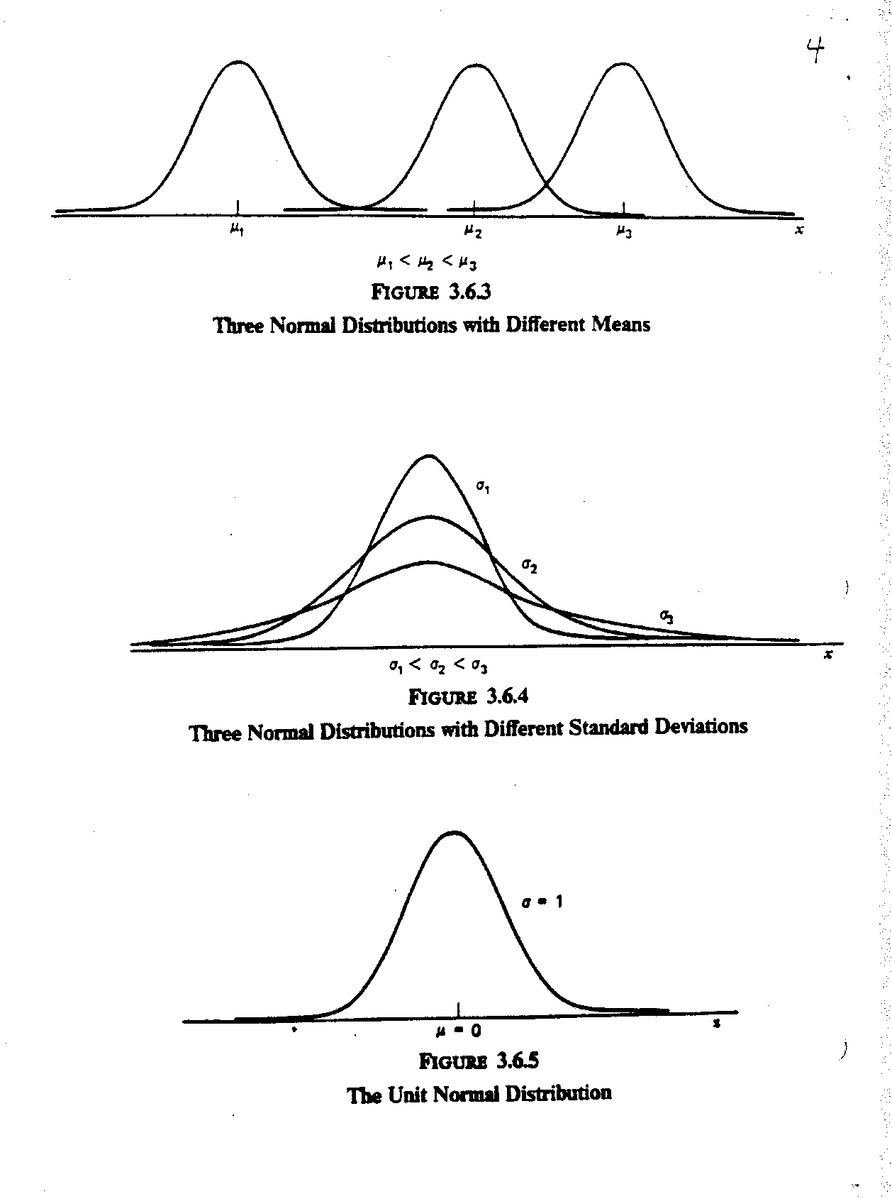

Slide 20
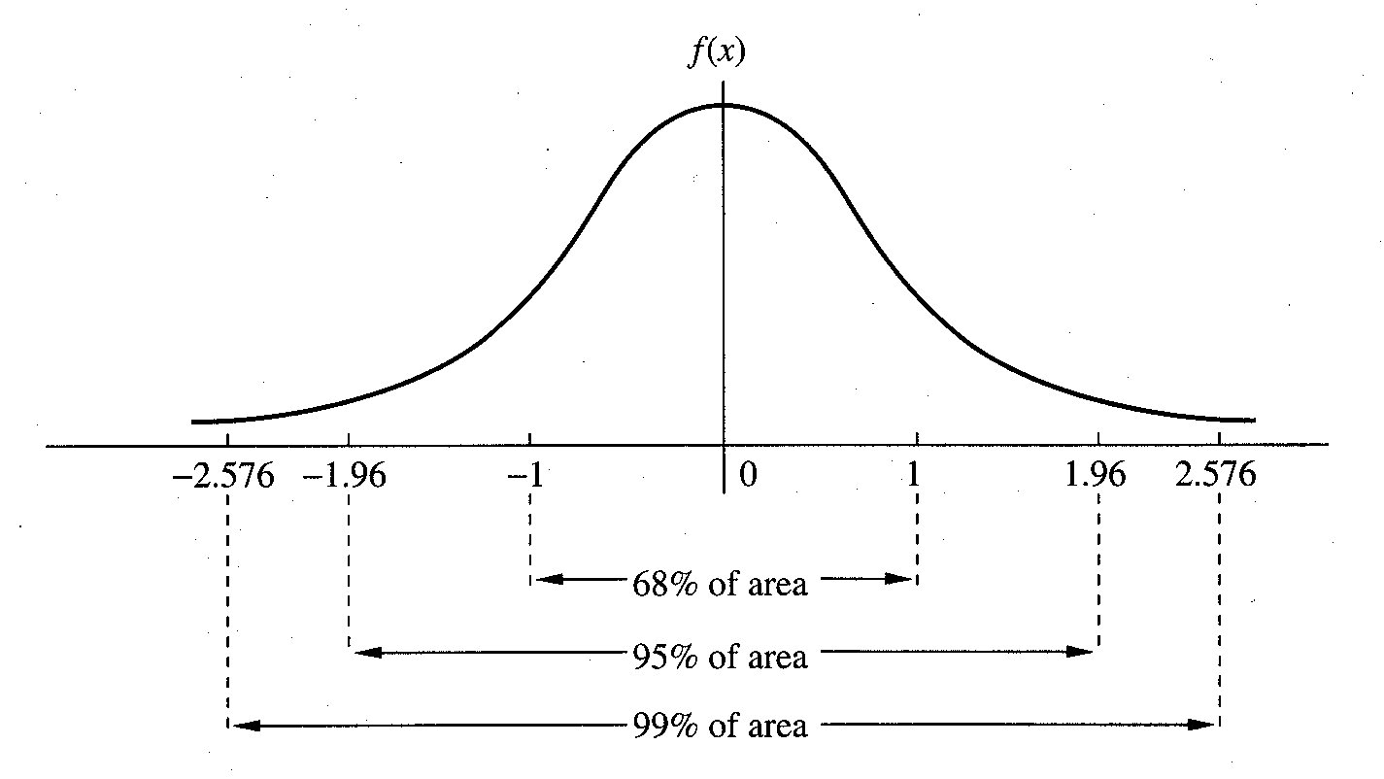

Slide 21
Normal Distribution - Calculating Probabilities
Example: Rosner 5.20
Serum cholesterol is approximately normally distributed with mean 219 mg/mL and standard deviation 50 mg/mL. If the clinically desirable range is < 200 mg/mL, then what proportion of the population falls in this range?
X = serum cholesterol in an individual.
μ =
σ =
negative values for cholesterol - huh?

Slide 22
Standard Normal Distribution - Calculating Probabilities
First, let’s consider the standard normal - N(0,1). We will usually use Z to denote a random variable with a standard normal distribution. The density of Z is
and the cumulative distribution of Z is:
Any computing software can give you the values of f(z) and Φ(z)

Slide 23
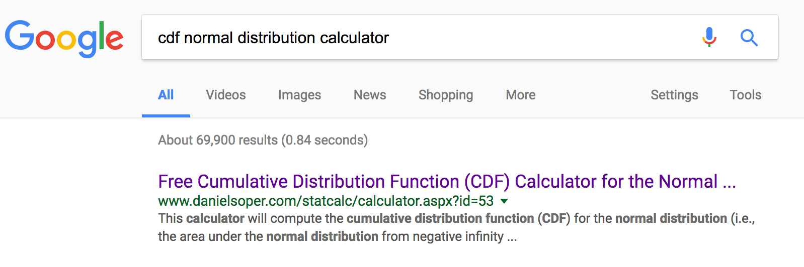
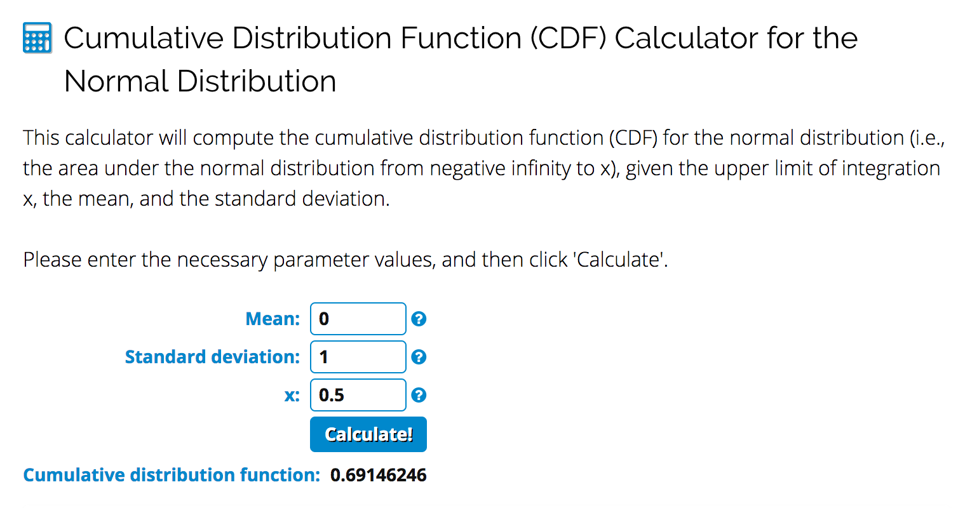
Standard Normal Distribution - Calculating Probabilities

Slide 24
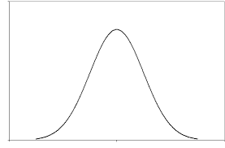
Facts about probability distributions
P[Z < z] = a
P[Z > z] = 1-a
P[Z < x] = b, P[Z < y] = c
Pr[x < Z < y ] = c-b
a
1-a
c
b
c-b

Slide 25
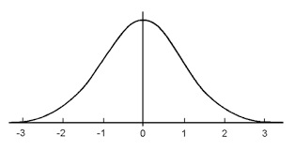
Facts about the standard normal distribution
Because the N(0,1) distribution is symmetric around 0,
Pr[Z < -y] = Pr[Z > y]
y
y

Slide 26
Quiz: 3 minutes
Google “cdf normal distribution calculator” and find the following if Z ~ N(0,1)
P[Z < 1.65] =
P[Z > 0.5] =
P[-1.96 < Z < 1.96] =
P[-0.5 < Z < 2.0] =

Slide 27
Solutions to Quiz
P[Z < 1.65] = 0.9505
P[Z > 0.5] = 1 – 0.6915 = 0.3085
P[-1.96 < Z < 1.96] = 0.975 – 0.025 = 0.95
P[-0.5 < Z < 2.0] = 0.9772 – 0.3085=0.6687

Slide 28
Converting to Standard Normal
This solves the problem for the N(0,1) case. Do we need a special table for every (μ,σ)?
No!
Define: X = μ + σZ where Z ~ N(0,1)
1. E(X) = μ + σE(Z) = μ
2. V(X) = σ²V(Z) = σ².
3. X is normally distributed!
Linear functions of normal RV’s are also normal.
If X ~ N (μ, σ²) and Y = aX + b
then
Y ~ N(aμ + b, a ²σ²)

Slide 29
Converting to Standard Normal
How can we convert a N(μ,σ²) to a standard normal?
Standardize:
What is the mean and variance of Z?
1. E(Z) = (1/ σ)E(X - μ) = 0
2. V(Z) = (1/ σ²)V(X) = 1

Slide 30
Normal Distribution - Calculating Probabilities
Return to cholesterol example (Rosner 5.20)
Serum cholesterol is approximately normally distributed with mean 219 mg/mL and standard deviation 50 mg/mL. If the clinically desirable range is < 200 mg/mL, then what proportion of the population falls in this range?
P( Z > 0.38)
= 0.3520.

Slide 31
Normal Approximation to Binomial
Example
Suppose the prevalence of HPV in women 18 -22 years old is 0.30. What is the probability that in a sample of 60 women from this population 9 or fewer would be infected?

Slide 32
Normal Approximation to Binomial
Example
Suppose the prevalence of HPV in women 18 -22 years old is 0.30. What is the probability that in a sample of 60 women from this population 9 or fewer would be infected?

Slide 33
Normal Approximation to Binomial
Binomial
When np(1-p) is “large” the normal may be used to approximate the binomial.
X ~ bin(n,p)
E(X) = np
V(X) = np(1-p)
X is approximately N(np,np(1-p))

Slide 34
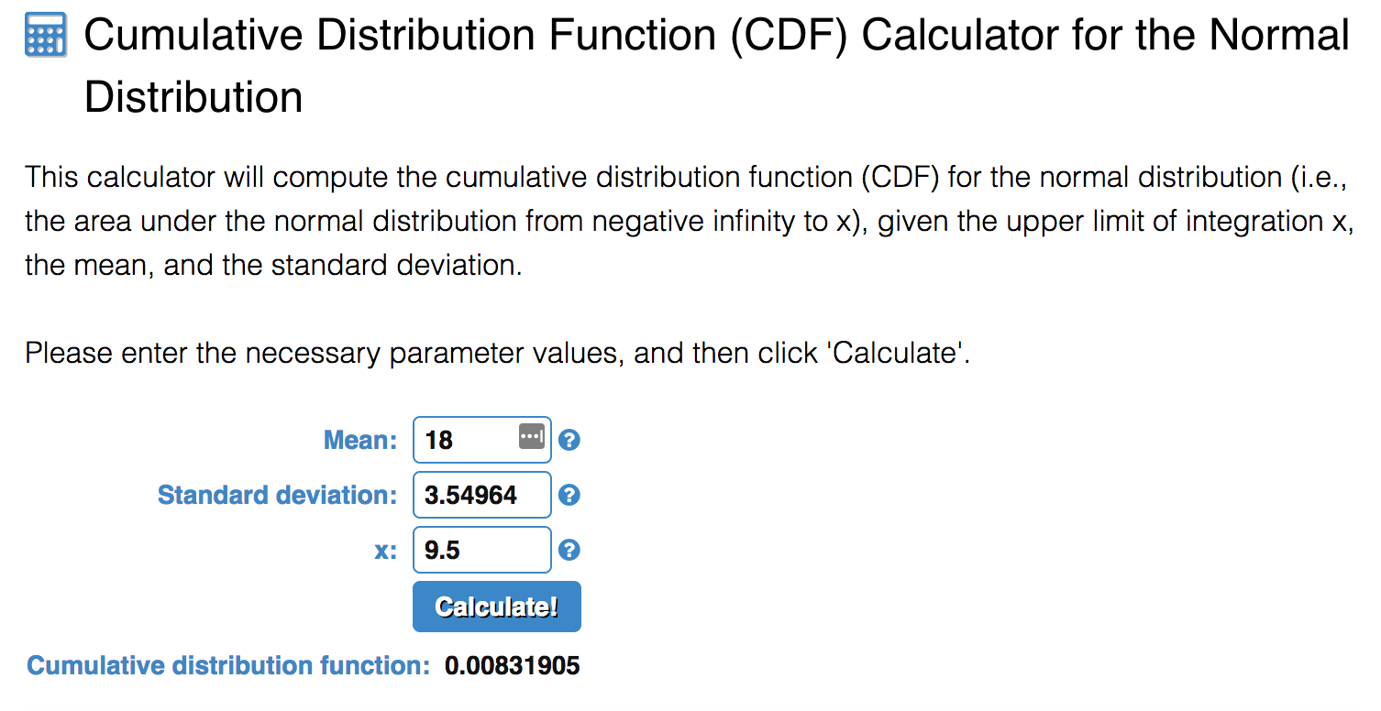
Normal Approximation to Binomial
Example
Suppose the prevalence of HPV in women 18 -22 years old is 0.30. What is the probability that in a sample of 60 women from this population that 9 or less would be infected?
Solution
X = number infected out of 60
X ~ Binomial(n=60, p =0.3)
X close to Normal distribution with mean 60*0.3=18 and variance 0.6*0.3*(1-0.3)=12.6

